Slide 1
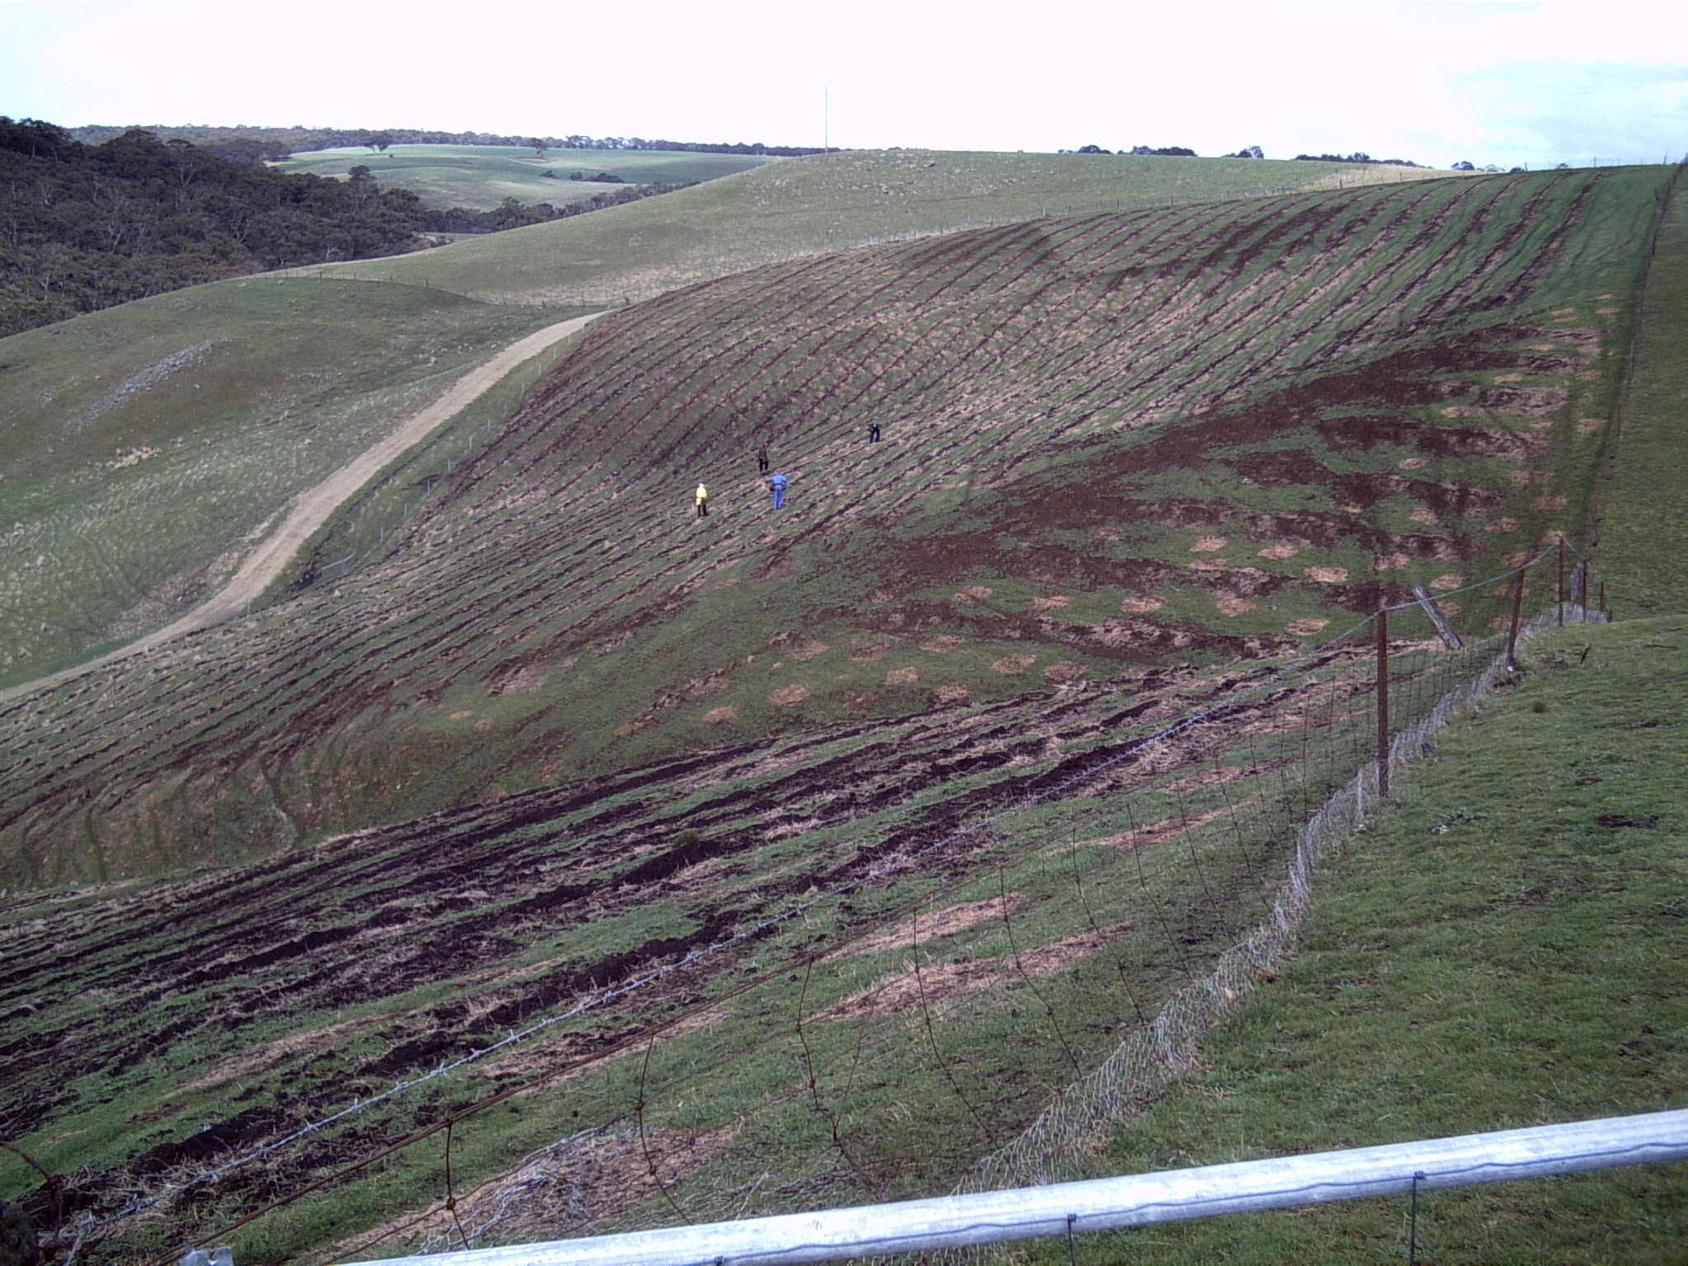
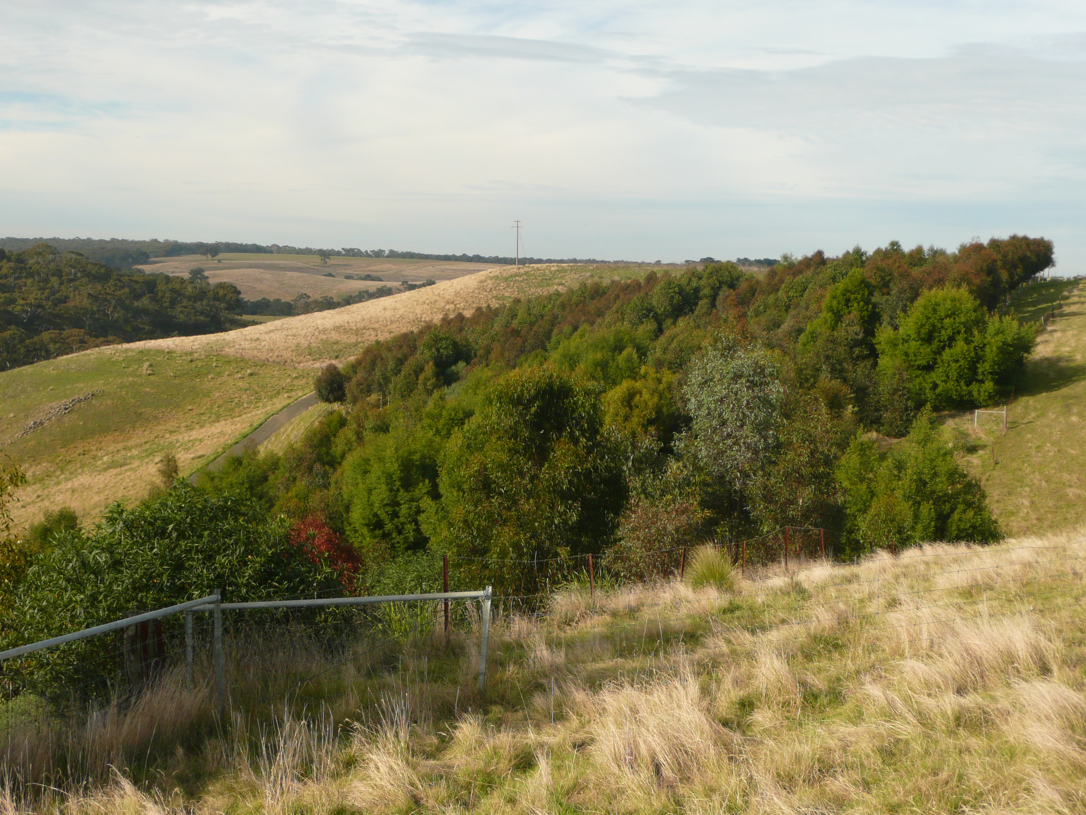
The BRT and Analog Forestry
Where to from here?

Slide 2
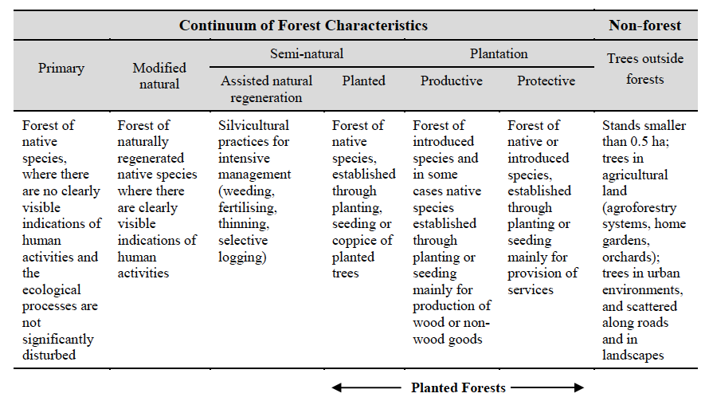

Slide 3
Industrial roundwood and fuelwood: actual global production
plus projected global supply from “planted forests”
Source: FAO

Slide 4
Regional breakdown of recent total global production
compared to future ‘planted forest’ supply

Slide 5
Regional breakdown of recent total global production
compared to future ‘planted forest’ supply

Slide 6
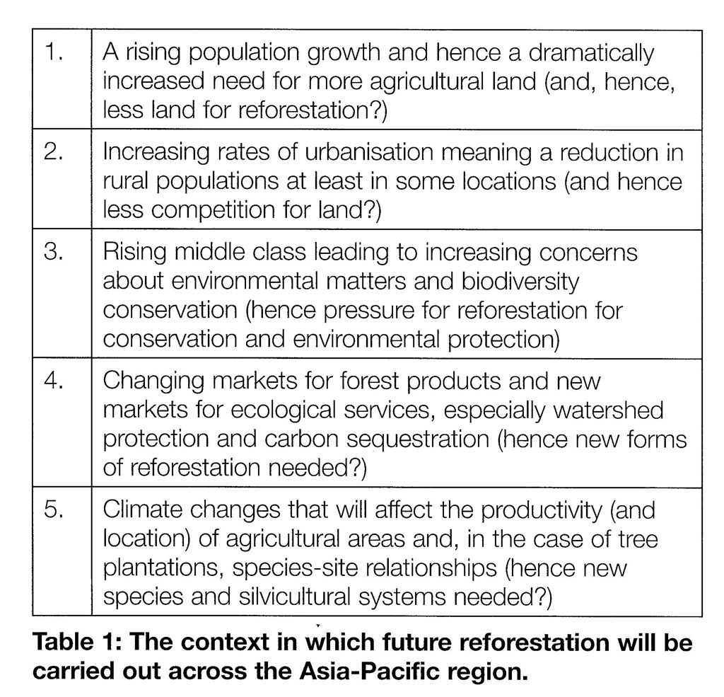
Changing the standard model of reforestation across the Pacific
(David Lamb, AFG, 2011)

Slide 7
“All of these potential trends suggest there is a need for new forms of plantation silviculture and that the methods that have served in the past will no longer prove sufficient. Simple monocultures of fast growing species may serve pulpwood production, but may be quite unsuitable for forests supposed to protect watersheds, conserve biodiversity or sequester carbon over long periods. ……………
What this means is that Australian forest growers should be willing to explore and innovate, testing new methods of reforestation and remaining open to the new opportunities that are likely to emerge.”
David Lamb ‘Australian Forest Grower’ Autumn 2011 p. 38

Slide 8
Analog forests
a tree-dominated ecosystem that is analogous in structure and function to the original climax and sub-climax community
over time, increases in diversity and stability
mimics the indigenous Climax State
replicates the efficiency and dynamics of the natural processes
designed to provide social and economic benefits
Source: Duffy, A. “Analogue forestry: a sustainable production system”
(http://www.gbcma.vic.gov.au/revegetation/1/Index5.html).

Slide 9
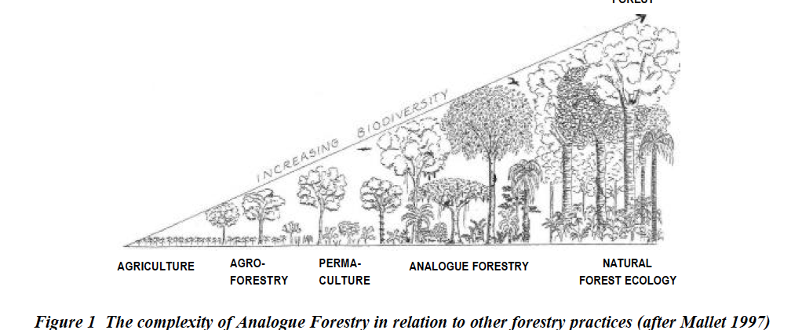

Slide 10
Analog Forestry is based on the following basic principles:
Observe and record
Understand and Evaluate
Know your land
Identify levels of yield
Map out flow and reservoir systems (existing and potential)
Reduce ratio of external energy in production
Be guided by landscape and neighbors needs
Follow ecological succession
Utilize ecological processes
Value Biodiversity
Respect Maturity
Respond Creatively

Slide 11
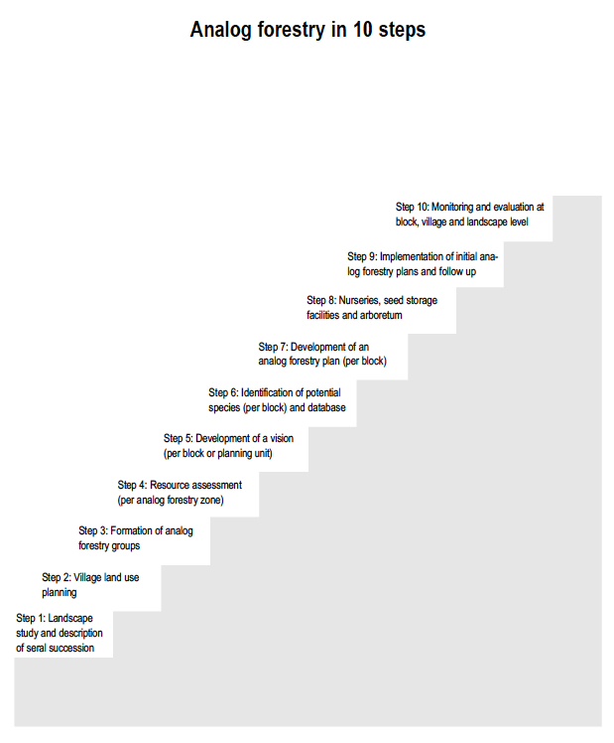

Slide 12
“Analogue forestry is a response that seeks to address both the genetic and cultural issues of biological loss”
Senanayake and Jack (1998) ‘Analogue Forestry: An Introduction’

Slide 13
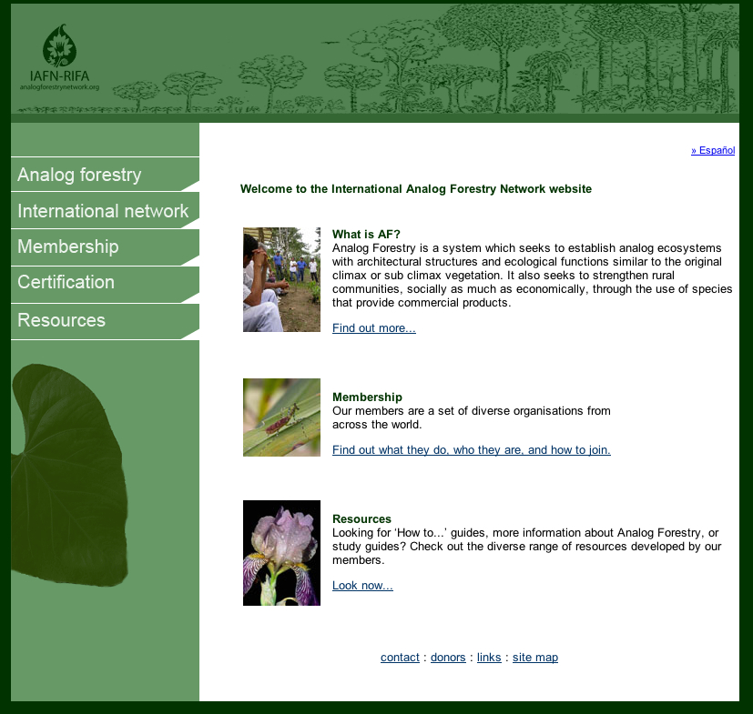

Slide 14
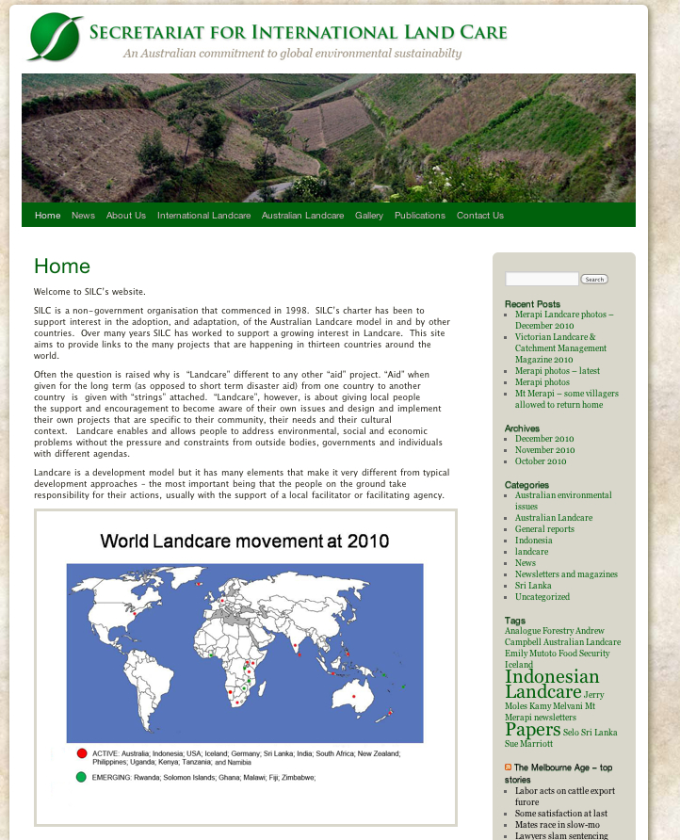

Slide 18
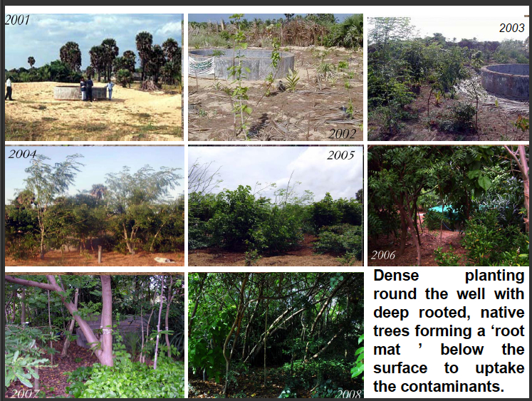

Slide 21
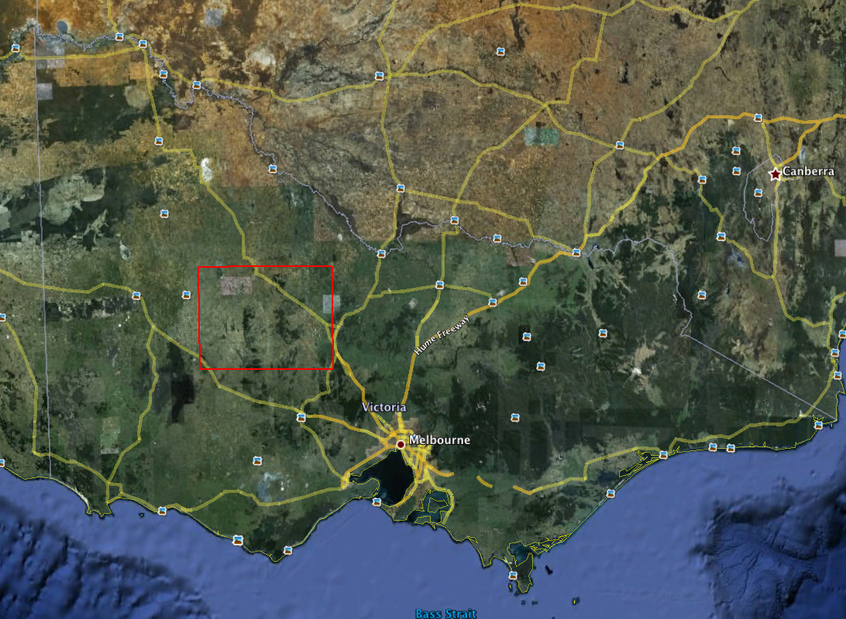
10% of Victoria’s agricultural land = 1.27 million ha

Slide 22
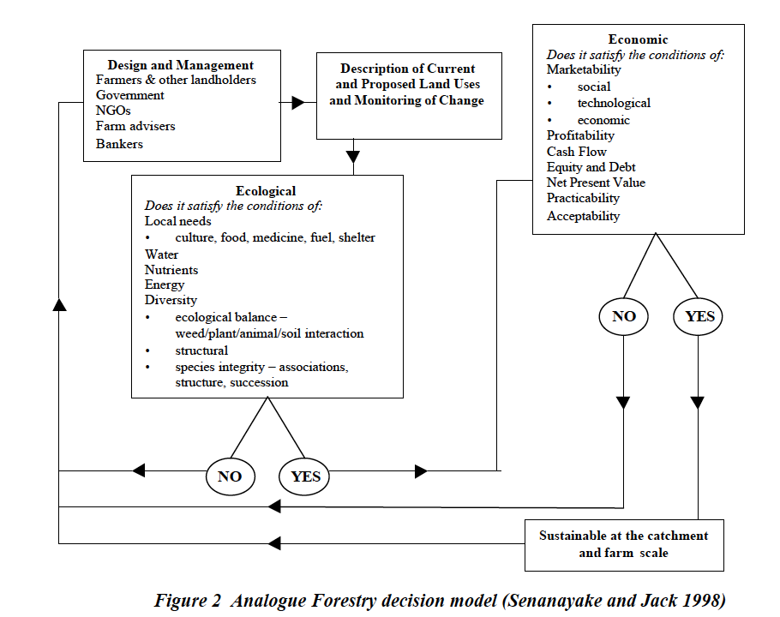

Slide 25
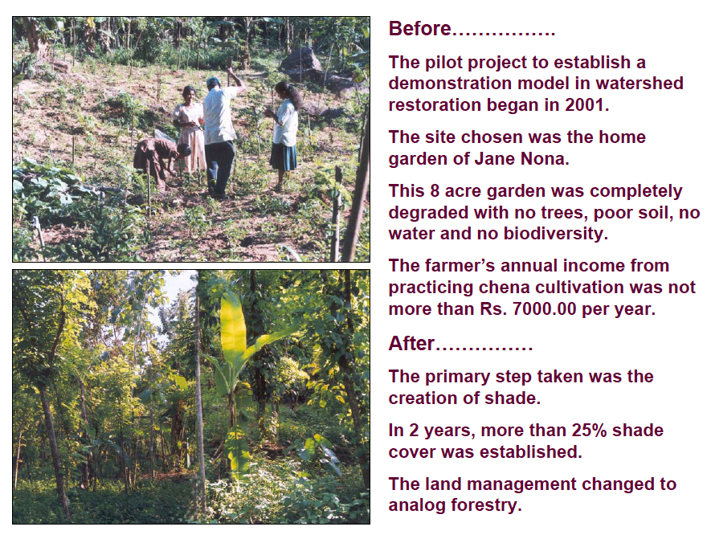

Slide 28
