Slide 1


Why bother monitoring?
Importance of long term monitoring of restoration efforts
Dr. Singarayer Florentine (Florry)
University of Ballarat

Slide 2

Global forest resources
4 billion hectares of forest (40 million km²)
30 percent of total land area
1.4 billion hectares of other wooded land

Slide 3
Modified natural forests
53 percent of the world’s forests

Slide 4
Deforestation in Brazilian Amazonia
Increased significantly during the last decade
1990-1994: 1.37 million ha/yr
1995-2003: 1.98 million ha/yr
W. F. Laurance et al. (2001) Environmental Conservation 28:305-311
W. F. Laurance et al. (2004) Science 304:1109.

Slide 5
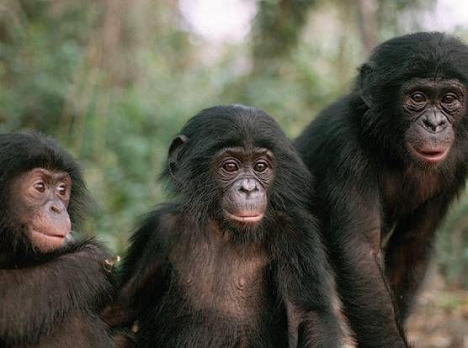
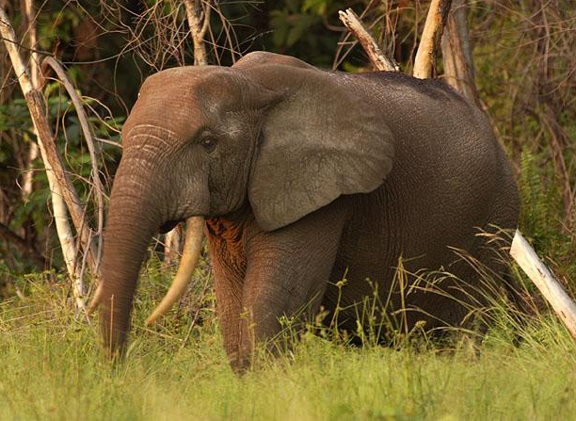
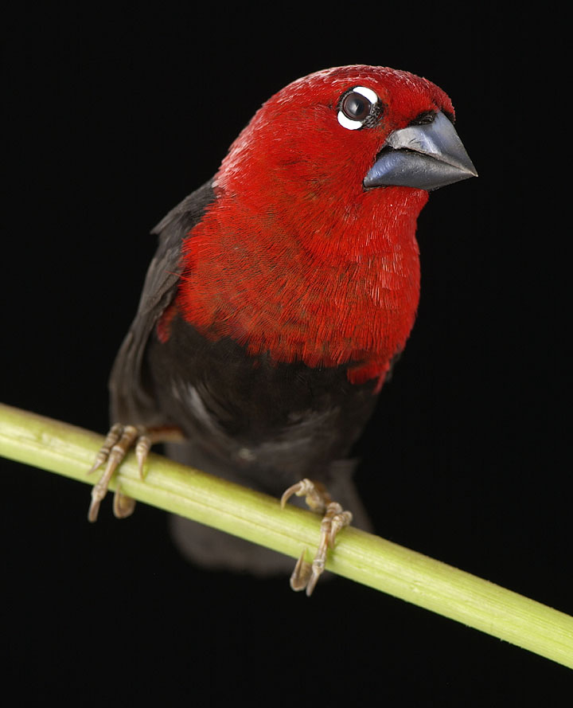
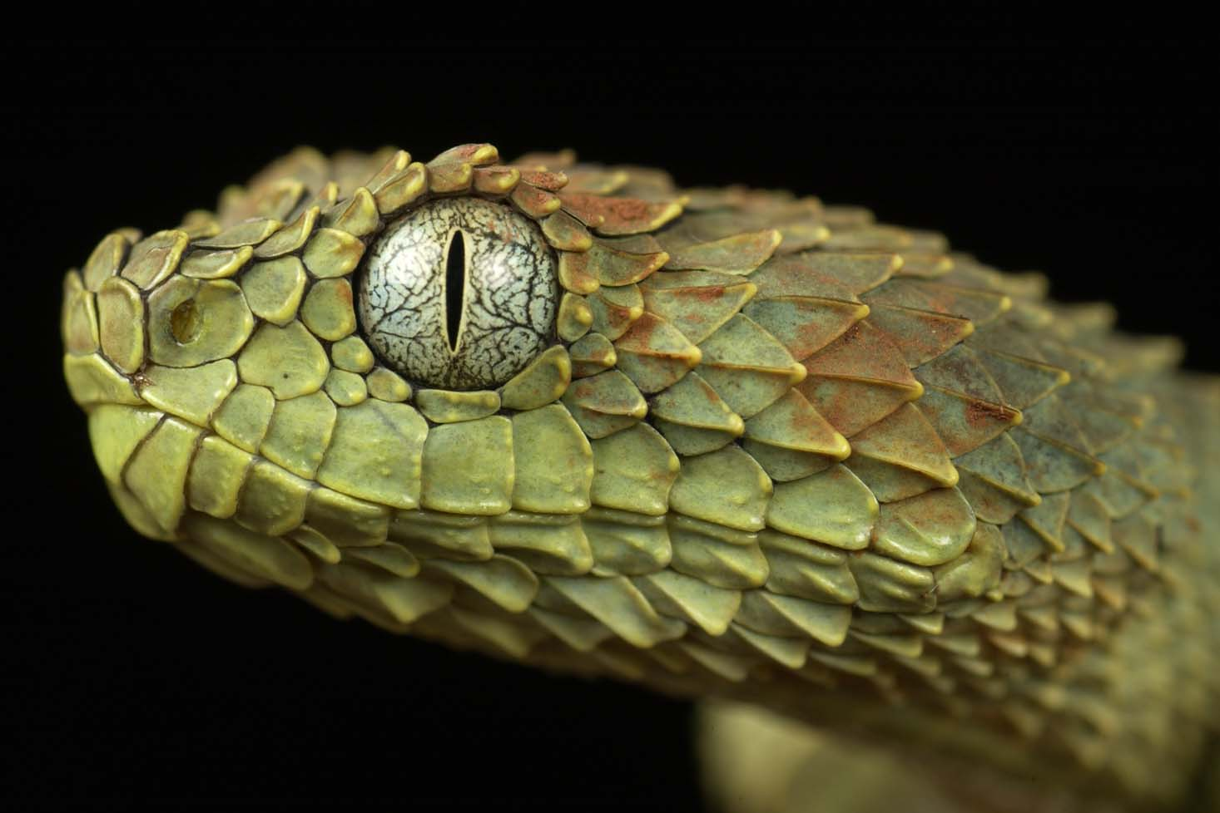
What is happening to Africa’s rainforests?
Acknowledge Photos: W. F. Laurance
Notes:
5

Slide 6
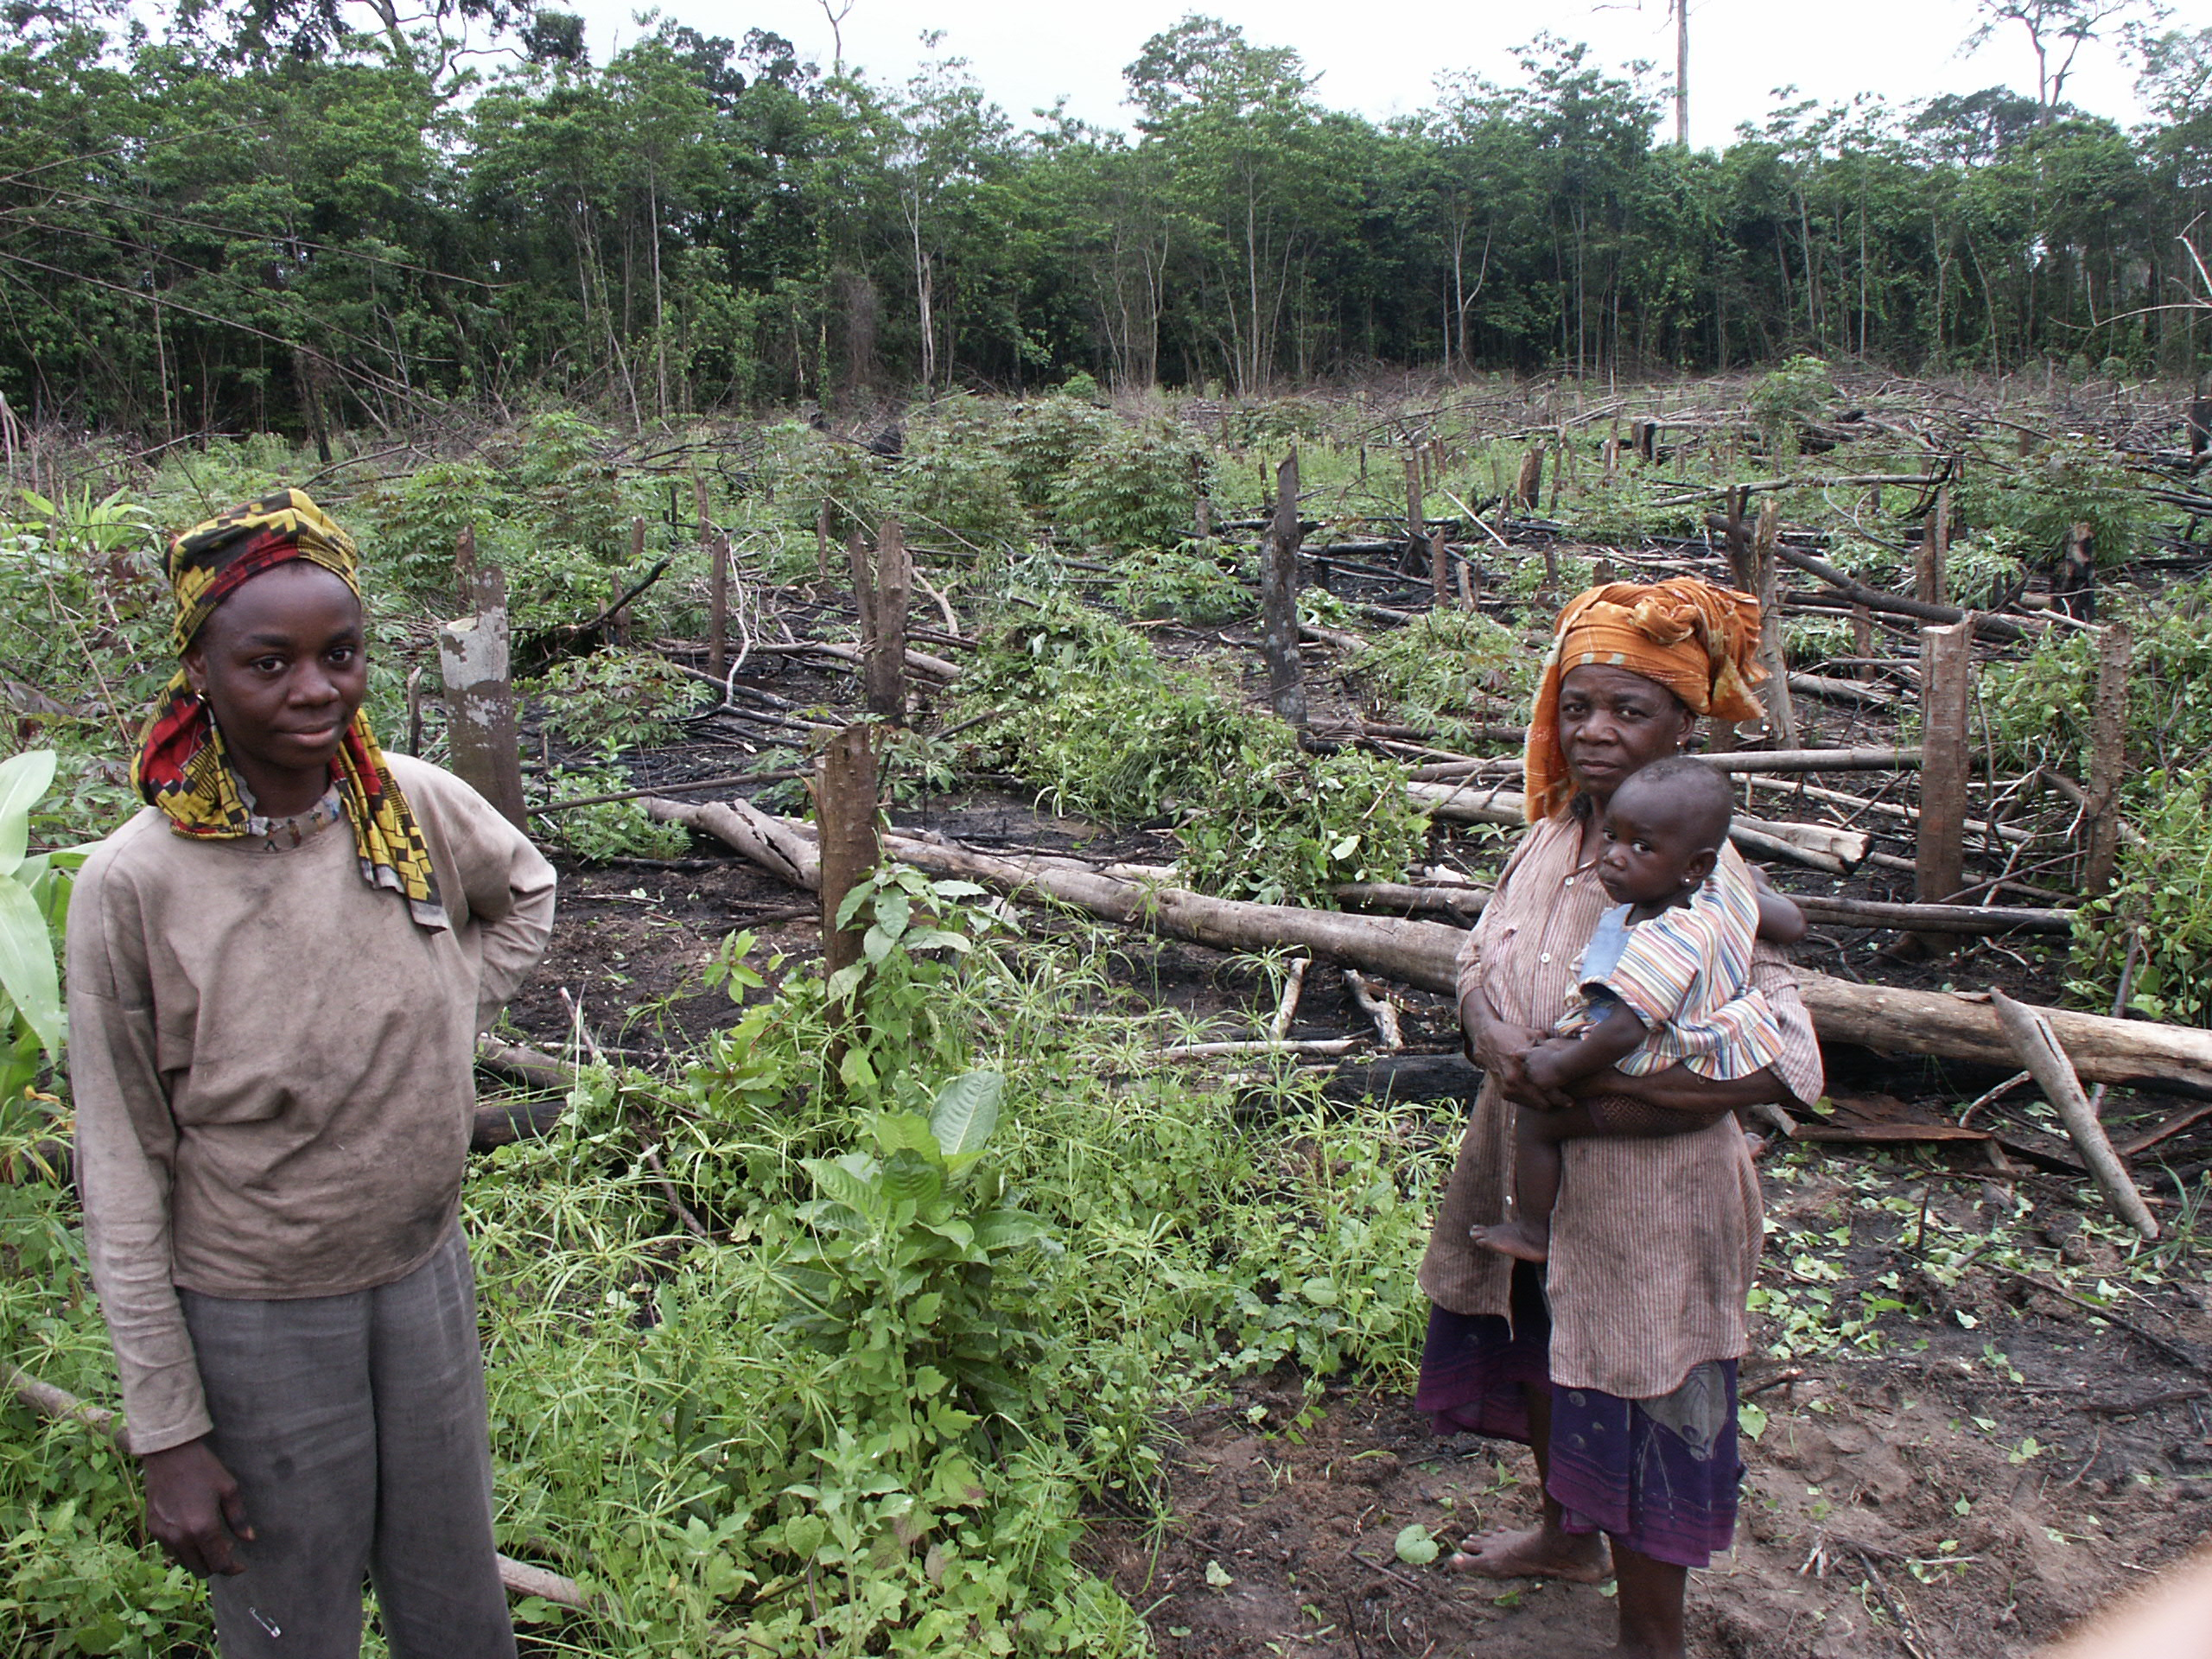
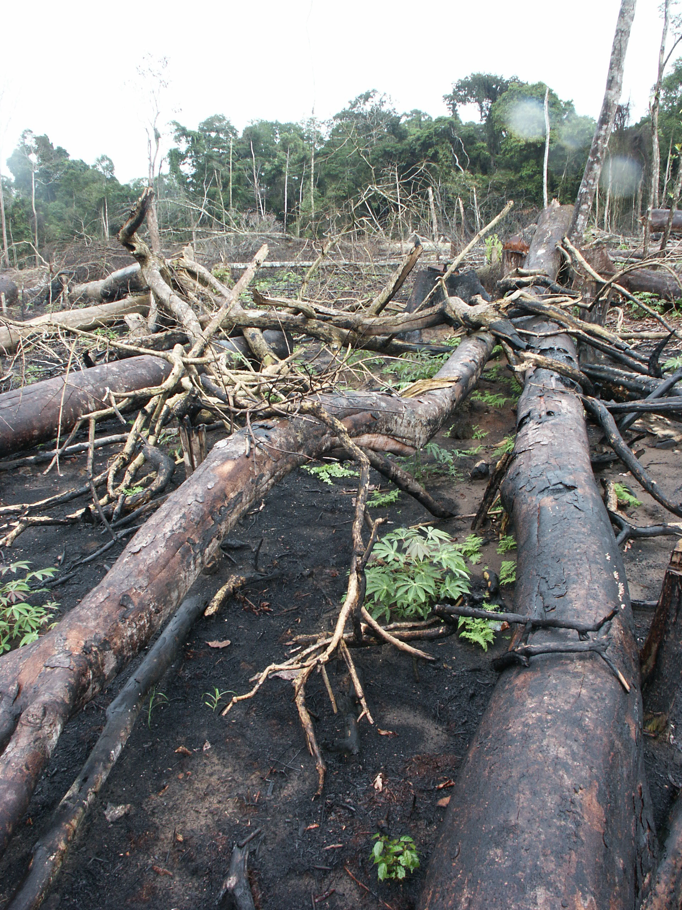
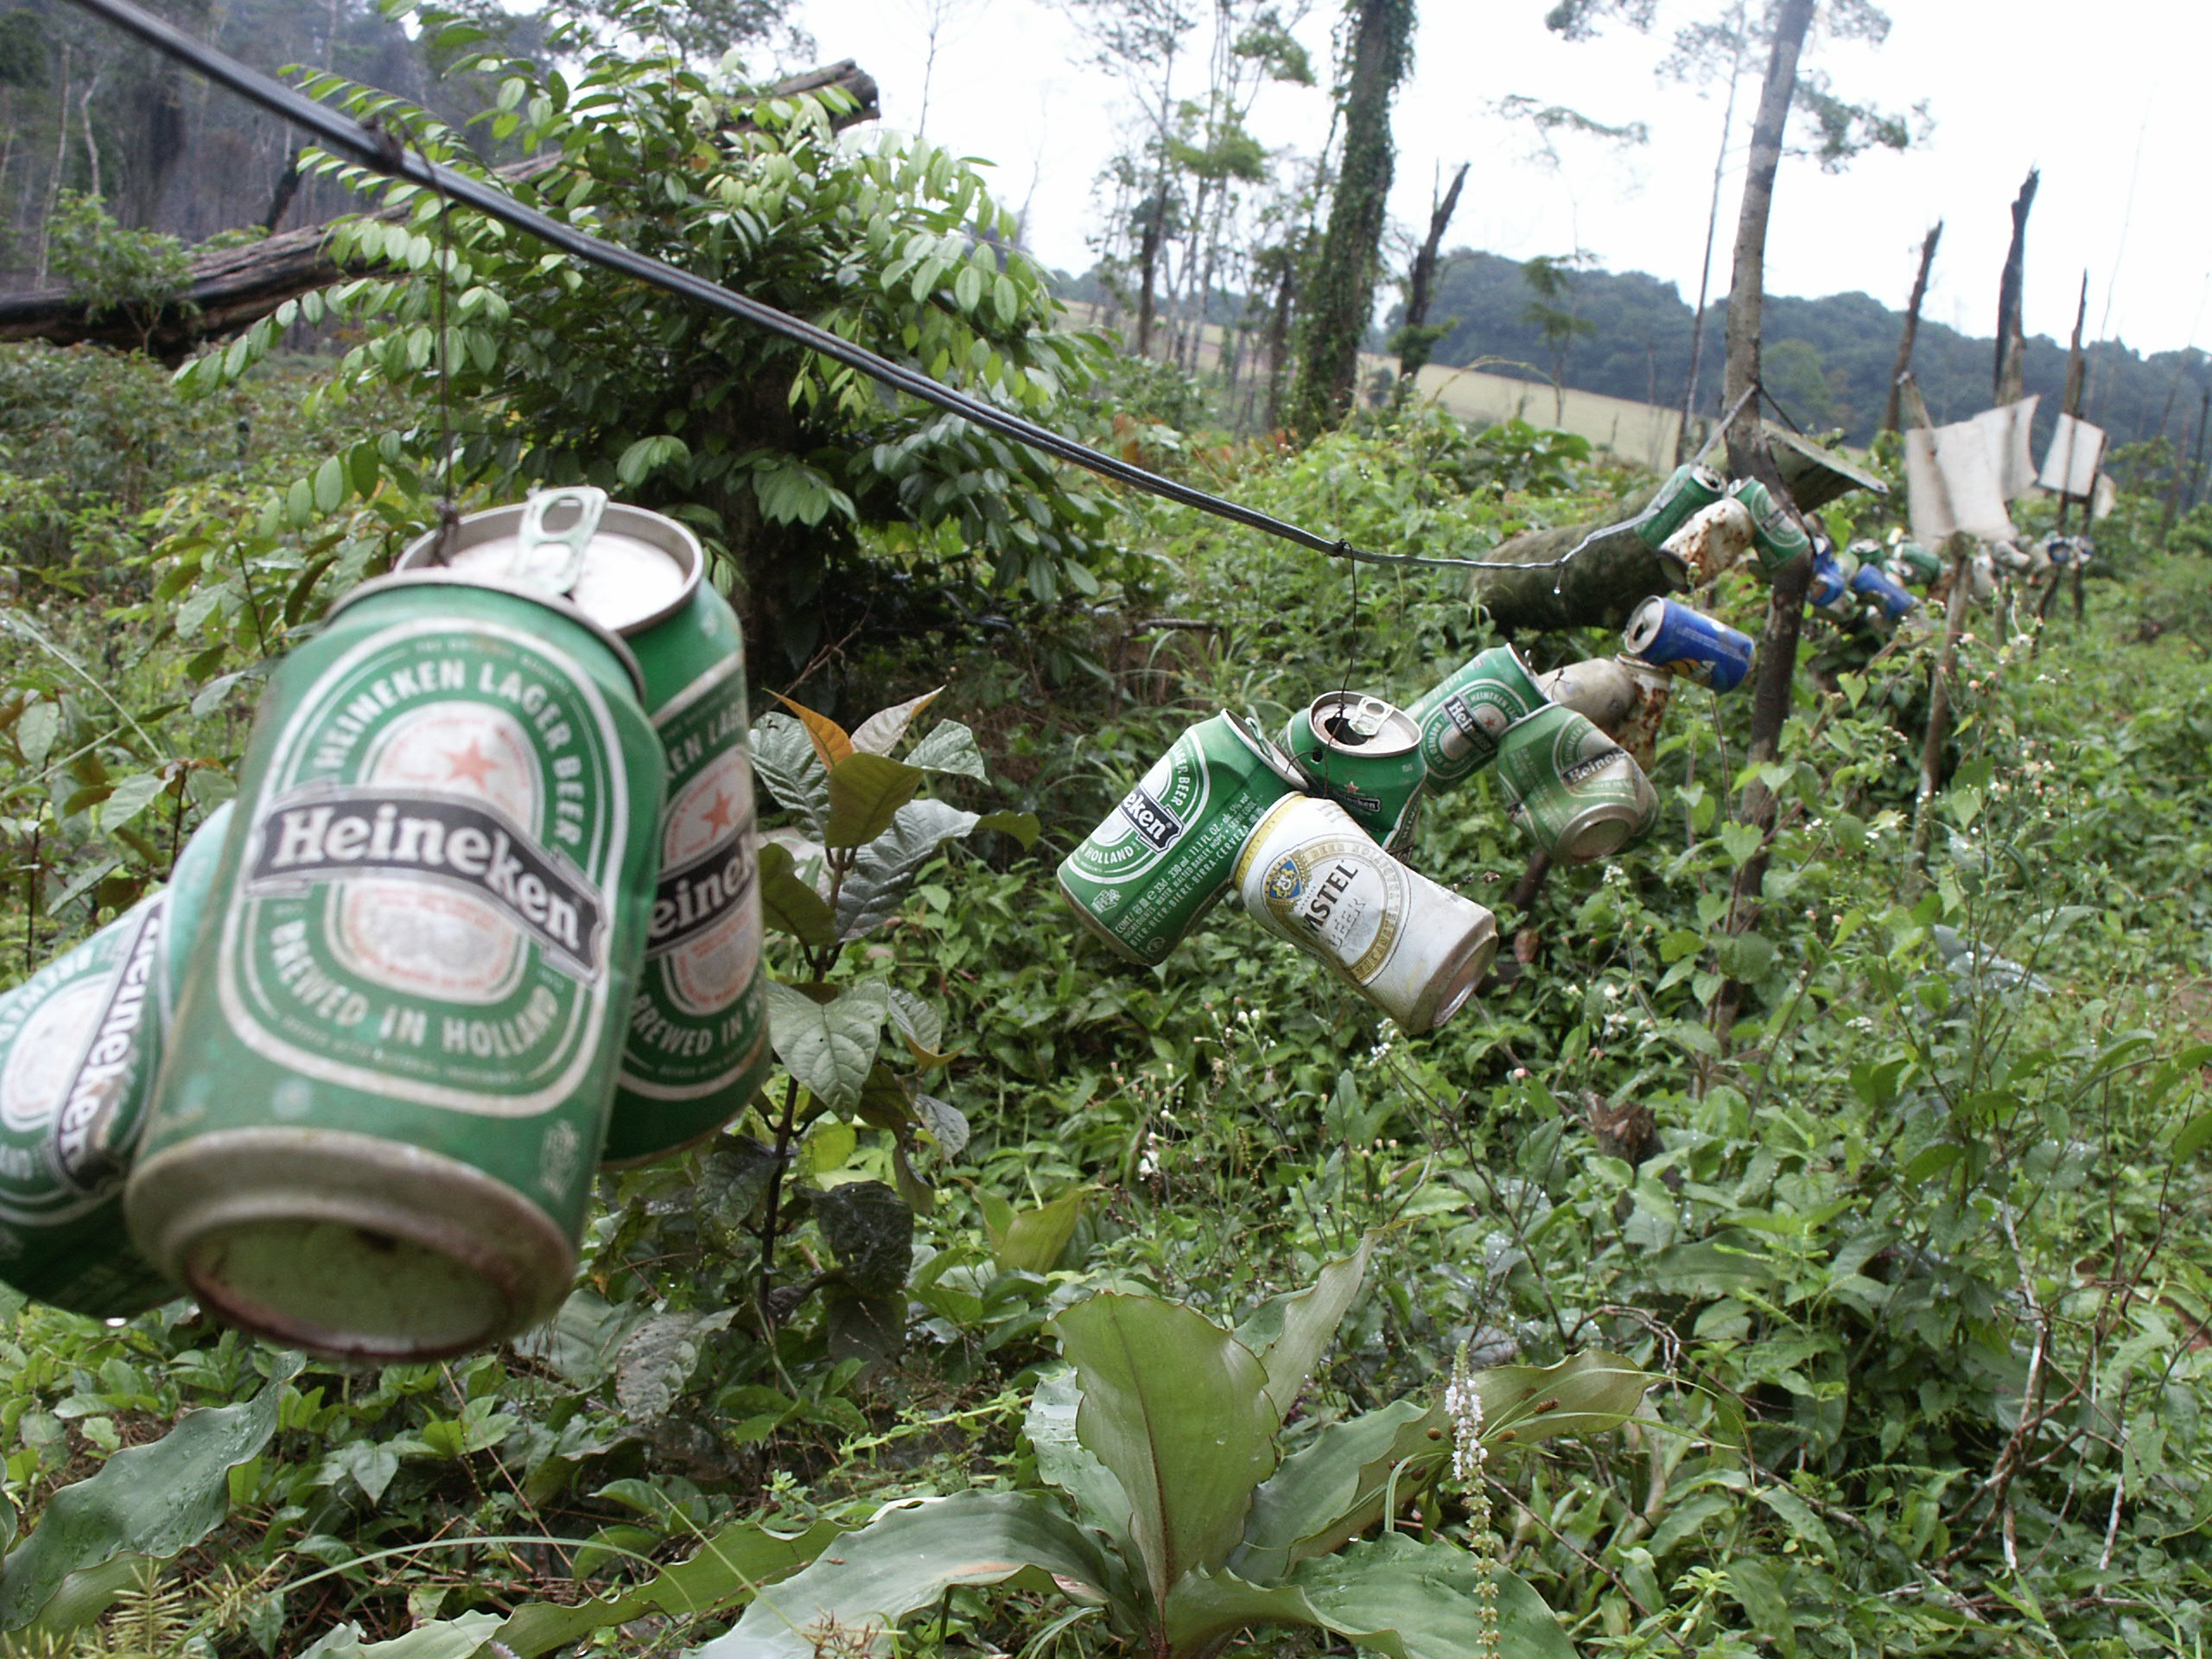
Deforestation: ~1 million ha/year
Acknowledge Photos: W. F. Laurance
Notes:
6

Slide 7
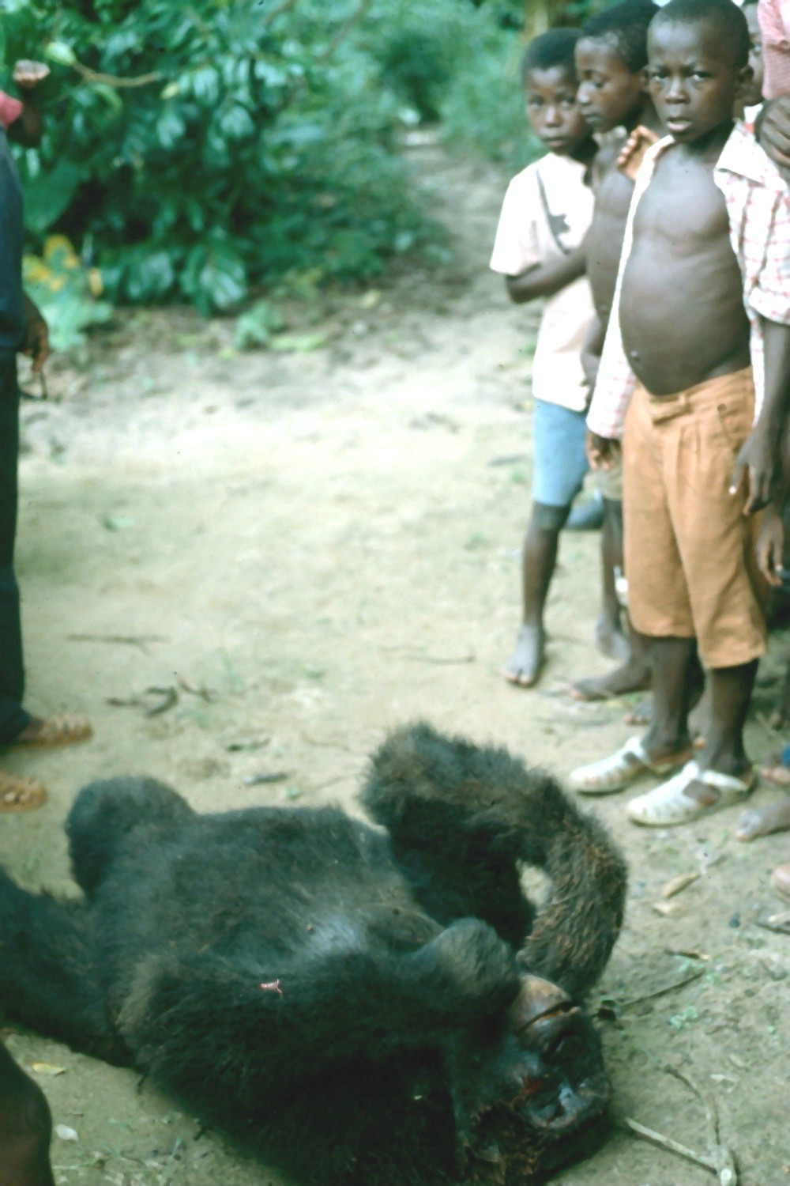
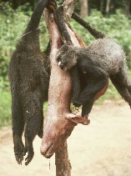
Bush meat Crisis

Slide 8
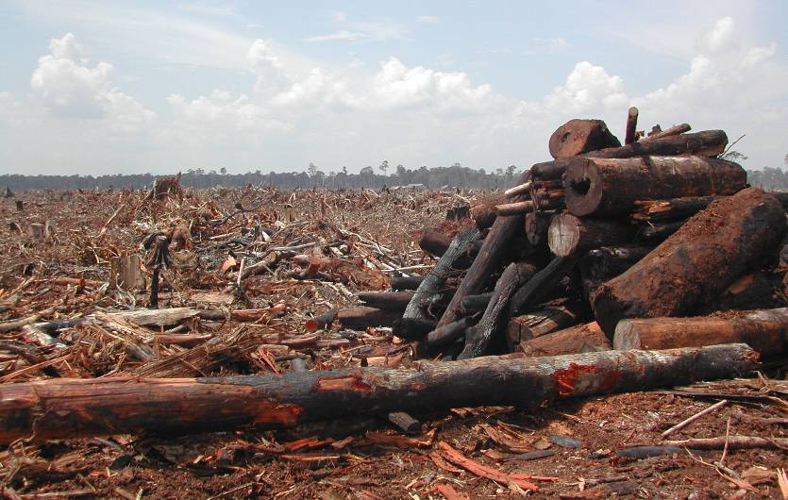
Global deforestation
Deforestation: 13 million ha/yr
Net forest loss 1990-2000: 8.9 million ha/yr
Net forest loss 2000-2005: 7.3 million ha/yr or 200 km2 per day
Notes:
8

Slide 9
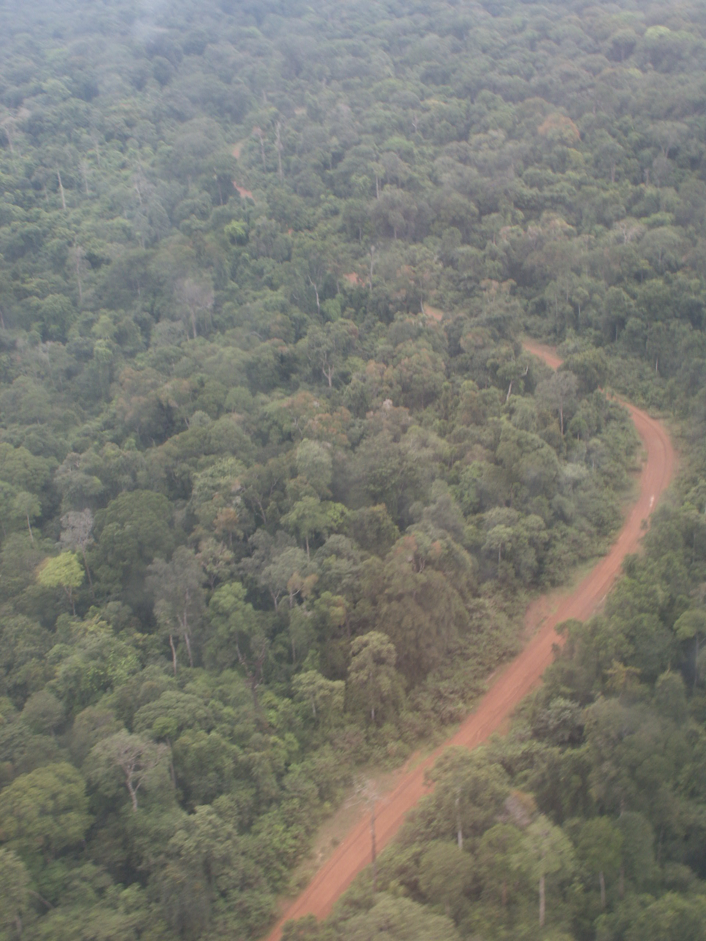
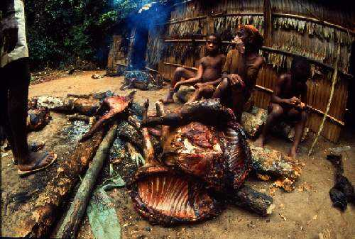
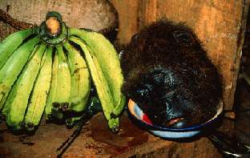
The Future: Empty Forests?
Acknowledge Photos: W. F. Laurance

Slide 10
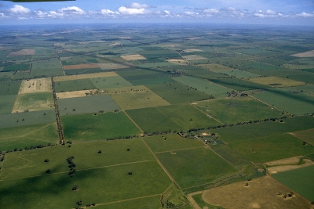
The Future: Empty Forests?

Slide 11
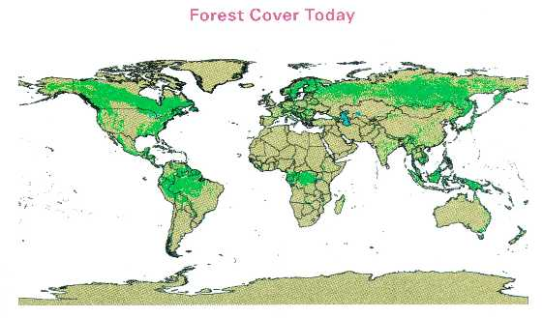
Whatever the case may be, human intervention is essential to accelerate the recovery process.
Notes:
11

Slide 12
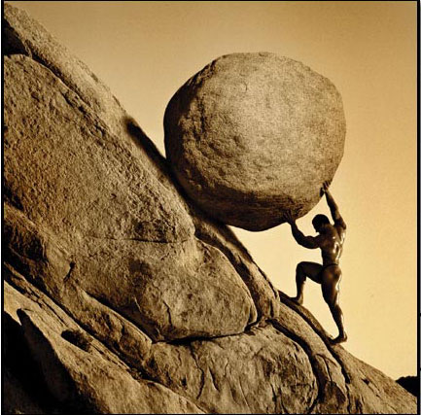
Restoration
efforts

Slide 13
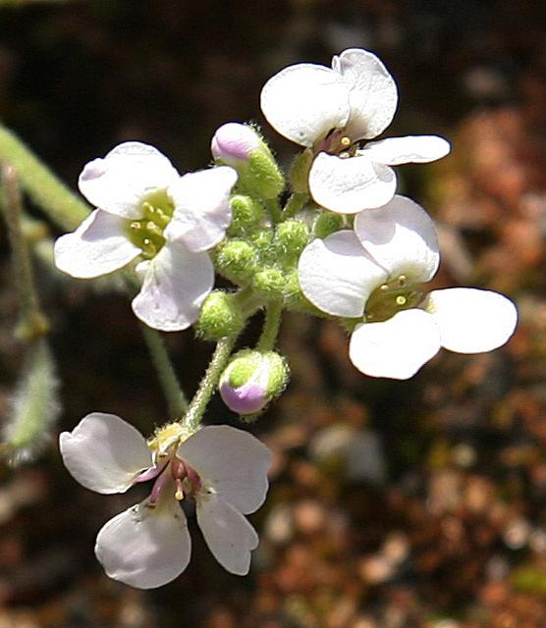
Purposes of restoration…..
Amenity.
Moral obligations.
Demonstrating that you are a good corporate citizen.
Habitat for desirable wildlife or threatened species.
Increase in local land values.
Create a sense of stewardship among a local community.
Desirable ecological functions
Maintain productivity for local consumptive uses.
Repair ecosystem structure and/or function.
Education.

Slide 14
Restoration?
“restoration is putting back exactly what was there previously and making sure it functions properly”!!!
To which time period in the past should our restoration programs or efforts be targeted?
Notes:
14

Slide 15


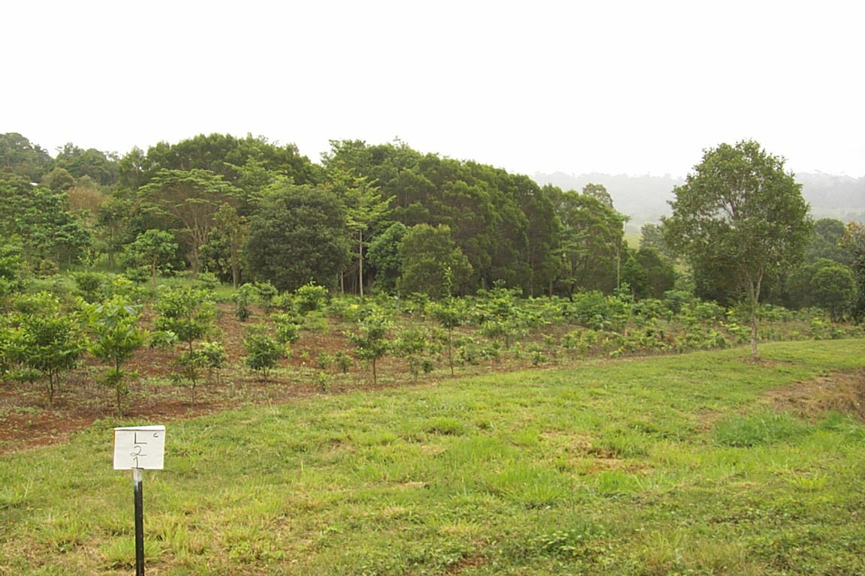
But at the end of the day…
We want to create a self–sustaining ecosystem
The question here is
Do we know what are doing?
Just do it
Purely the best

Slide 16
Restoration needs to be integrated at the landscape scale
Restoration should not be ad-hoc - it should fit in with a plan at a landscape scale.
Example is in creating habitat corridors within and between catchments.
The most critical component of a restoration project is -identifying objectives.
Without clear objectives (before work starts) of what restoration is to achieve, it will be impossible to determine whether it has been successful.

Slide 17
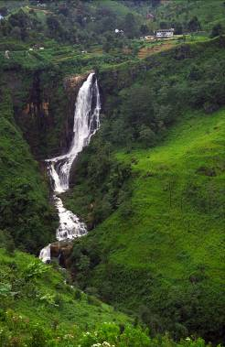
Scientific protocols
Ecologists have concerns regarding the ecological value of many restoration projects.
Need to develop a scientifically-based, but practical working protocols so that aims, practices and evaluation are appropriate.
Criticisms from ecologists of various restoration projects include:
  Restoration is often defined by actions rather than the ecological outcomes of these actions.
  Funding programs focus on on-ground action rather than ensuring this on-ground action has ecological merit.

Slide 18
Restoration projects
Over the last two decades the Australian government has invested heavily in restoration projects nation-wide.
In 2000–01 alone, $36.4 million was spent to re-establish native vegetation.
Environment Australia (1999) reported that the major on-ground outputs from its $27.1M Bushcare funding program included 10,000 ha direct seeding, the planting of 4.5 million seedlings and the erection of 12,000 km of fencing.

Slide 19
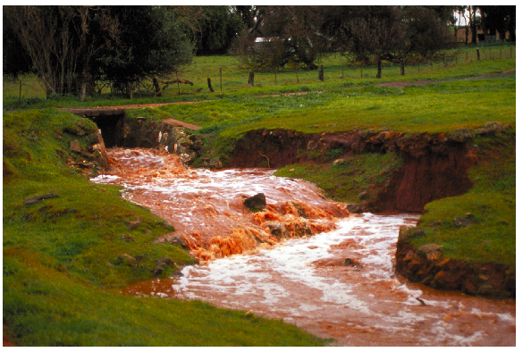
On-ground outcome
Recent review reported that, of the 2,247 restoration projects undertaken in four catchments in Victoria,
  only 14% included some form of monitoring,
  mainly by way of photographic records.
  In most restoration projects the on-ground outcome is largely untested.
  Even simple measures, …level of natural recruitment mortality….etc

Slide 20
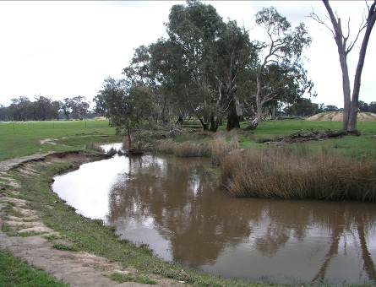
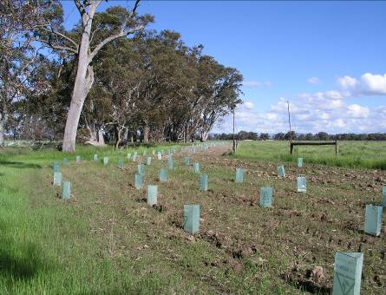
Evaluating restoration.
Evaluation is critical !!!!!!!
Without evaluation- poor methods of restoration may be continued while appropriate methods may be discarded or not further developed.
Ideally requires rigorous experimentation.
The details of assessing restoration is dependent on the objectives.
Variables to measure must be meaningful with respect to the objectives.

Slide 21
Ecosystem
“Novel ecosystems”
Surrounding matrix
Ecosystem attributes
Restoration
Climate change
Ecosystem
Abiotic
Fragmented
Ecosystems
biotic
Degraded
Ecosystems
Original ecosystem
Time

Slide 22
What are the benefits?

Slide 23
Treatment 1: Frame work species method
Only Omalanthus novo-guineensis (63)

Slide 24
Treatment 2: Frame work species method
O. novo-guineensis (23) +
8 Primary and promoters (5)
Treatment 3: Frame work species method
Alphitonia petriei (23) +
8 Primary promoters (5)

Slide 25
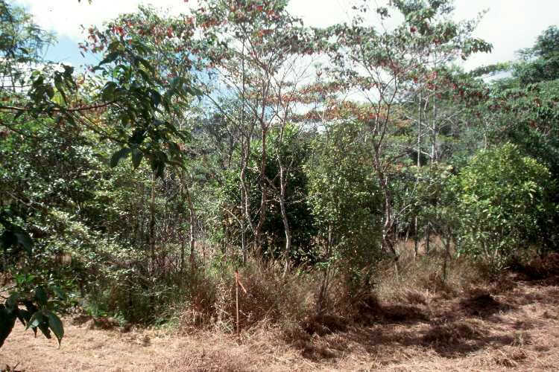
Treatment 4: Maximum species diversity method
10 Primary promoters (2)
7 Middle phase species (3)
7 Mature phase species (3)

Slide 26
Treatment 5: Control

Slide 27
After 14 years…
Seedling recruitment under different treatments
 | T1 | T2 | T3 | T4 | T5 (cont.)
Total no of families | 5 | 9 | 5 | 7 | 6
Total no of species | 5 | 11 | 6 | 7 | 6
Total number of individual | 10 | 239 | 36 | 99 | 13

Slide 28
Soil
(i) Nitrate-N
 | mg/kg
Rainforest | 5.0 - 11.0
Abandoned pasture | 3.0 - 4.0
Rehabilitated area | 3.0 - 4.0

Slide 29
Ordination: Vegetation

Slide 30
Ordination: bird species

Slide 31
Hemipteran Succession
Stress: 0.11
Forest
9 year old pits
6 year old pits
4 year old pits
Non-metric multi-dimensional scaling
Mel, K (2007)

Slide 32
Plant Succession
Stress: 0.09
Forest
9 year old pits
6 year old pits
4 year old pits
Non-metric multi-dimensional scaling
Mel, K (2007)

Slide 33
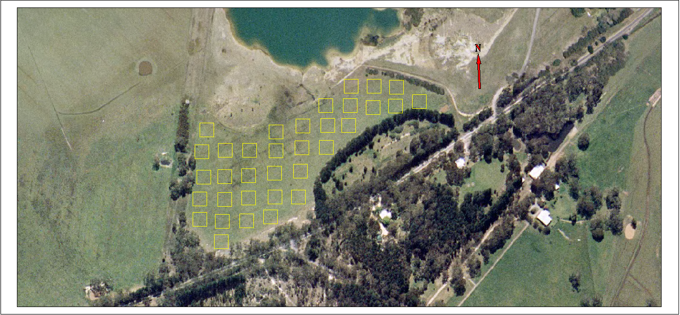

Biorich demonstration plantation

Slide 34
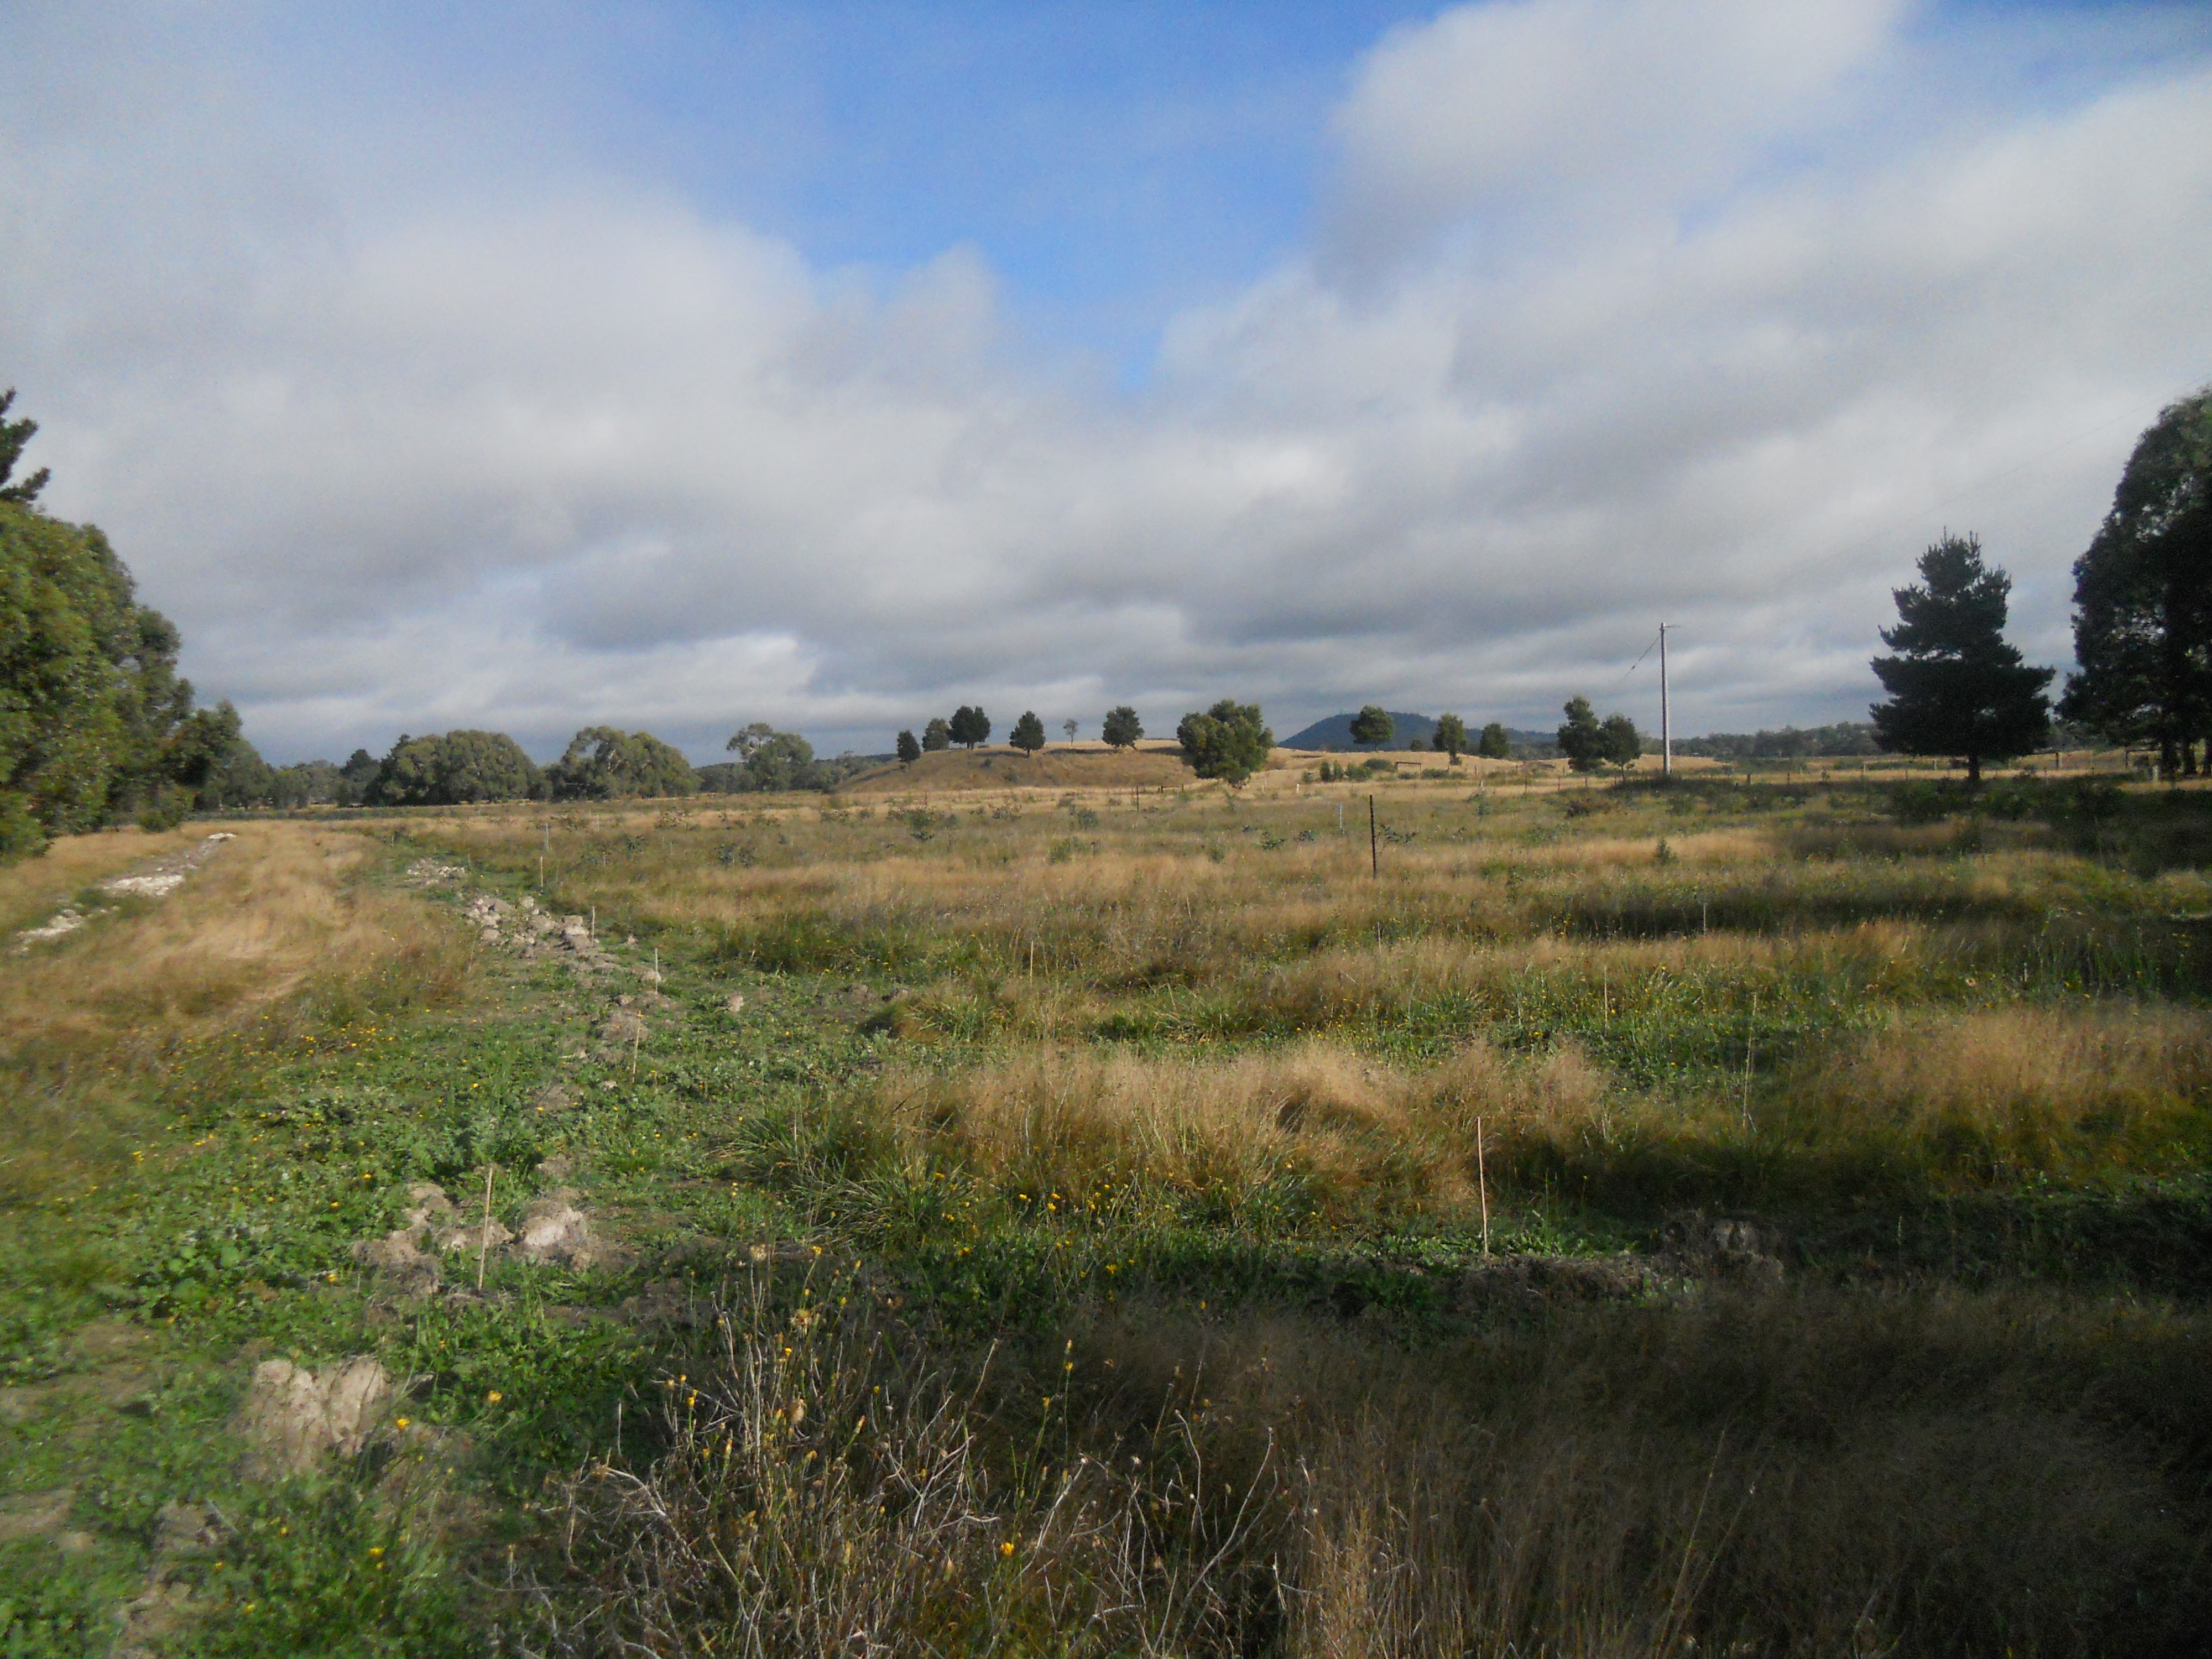
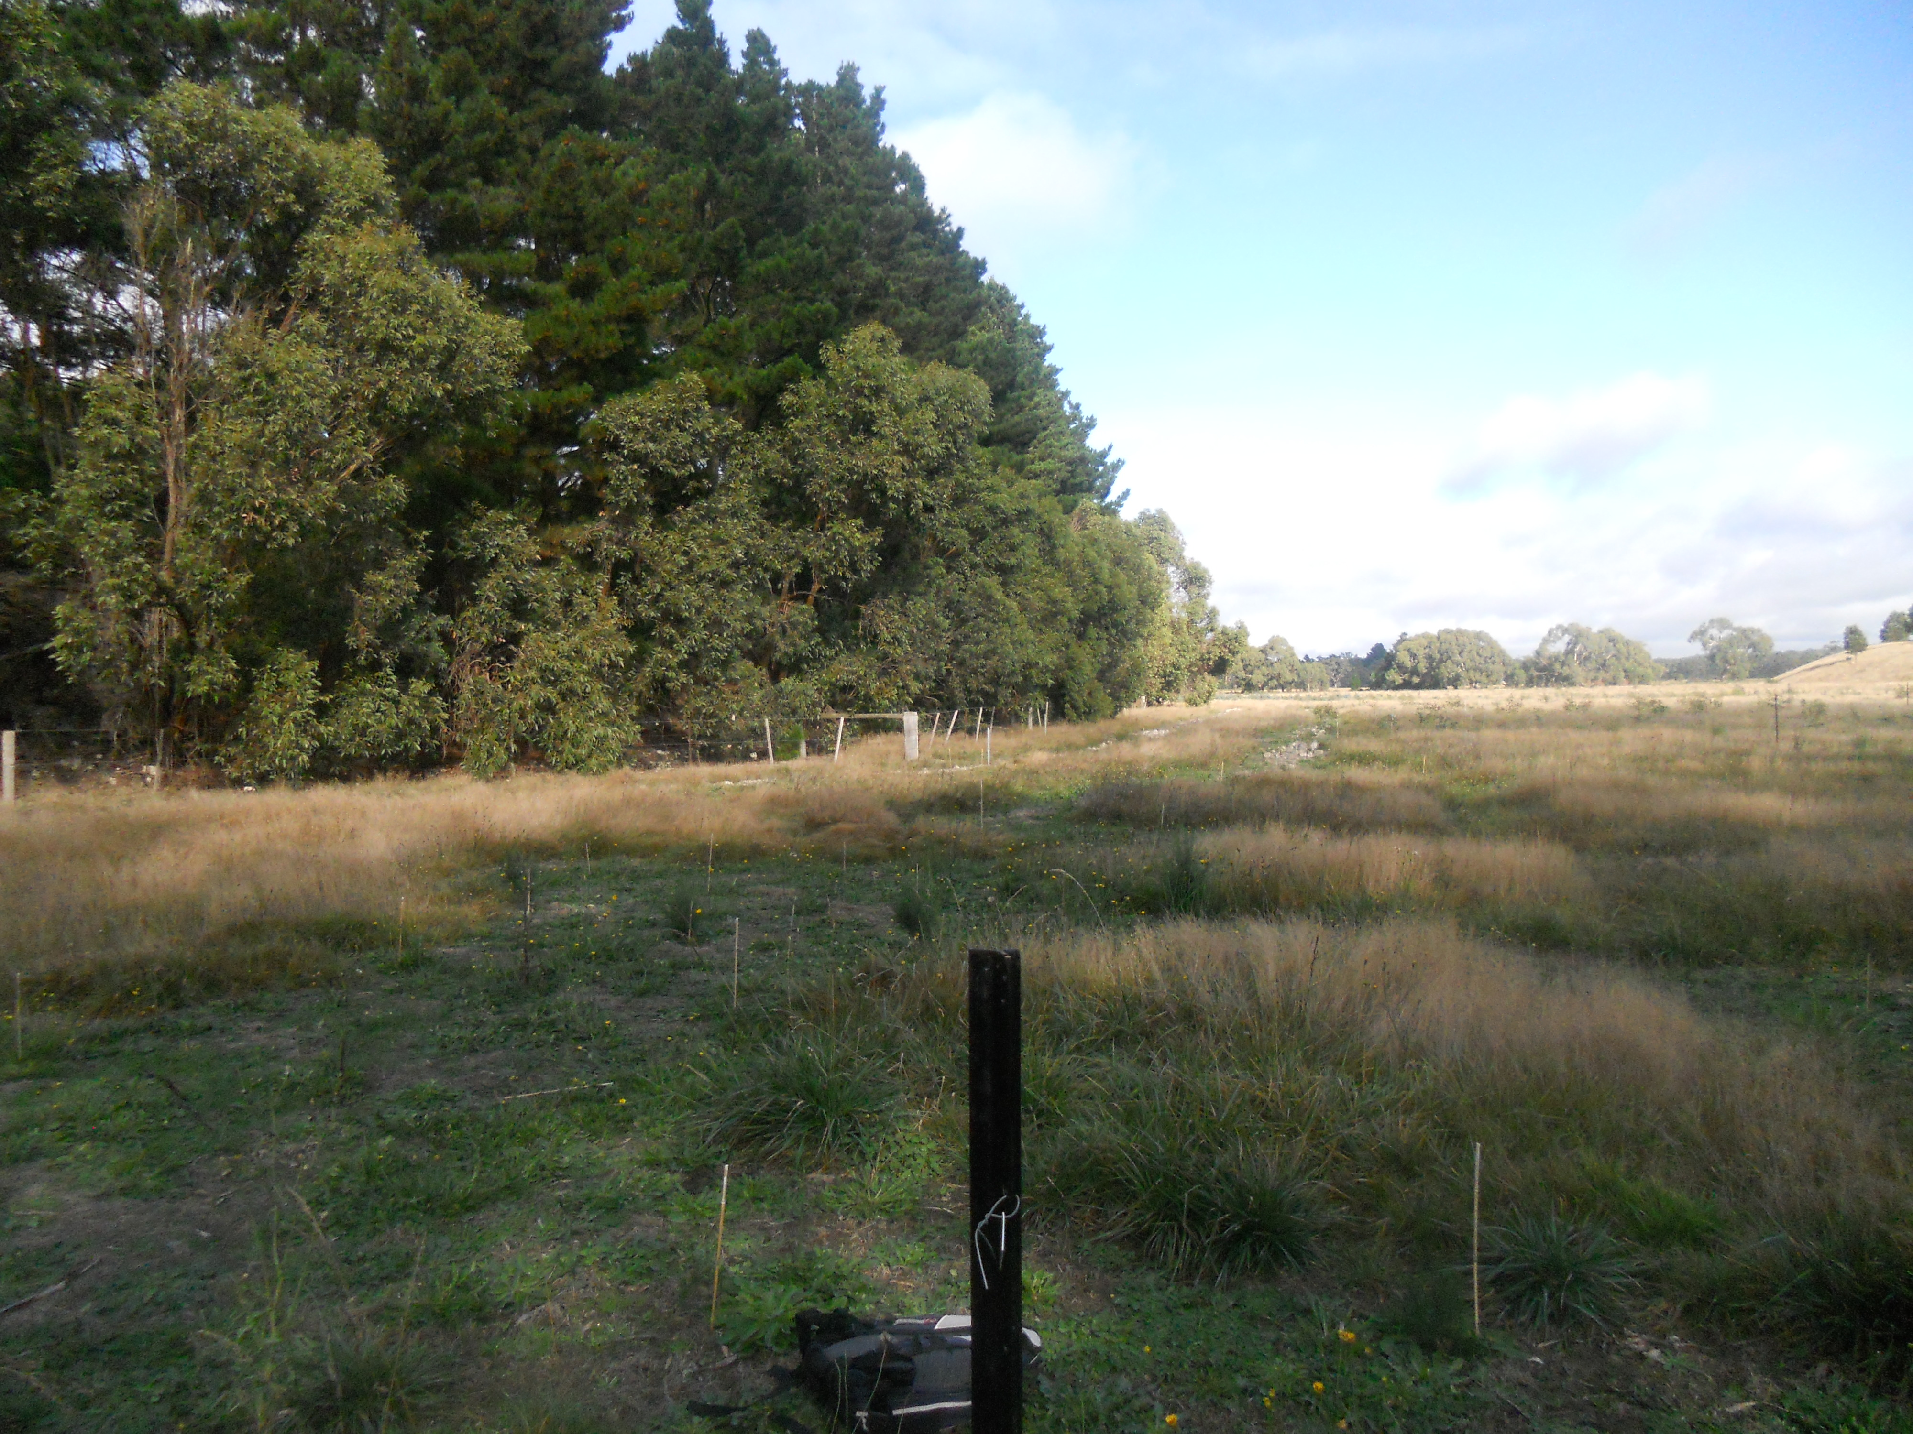
20m
20m
Notes:
34

Slide 36
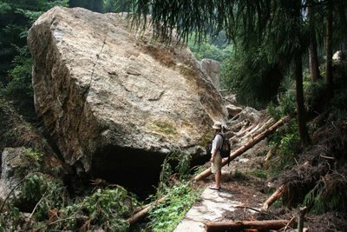
We do not want our efforts wasted…

